Slide 1
Unifying ideas
Building for-credit information literacy courses around themes to optimize student learning
Elizabeth Price and Rebecca Richardson Murray State University

Slide 2
Learning outcomes
Attendees will be able to
describe advantages of organizing for-credit information literacy courses around themes in order to increase student learning.
identify and develop themes in order to redesign their own for-credit information literacy courses.

Slide 3
What are you doing?
Do you teach a for-credit information literacy course? http://goo.gl/qKVjad
How many credits is your course? http://goo.gl/gxv3j9
What are your frustrations with teaching an info lit course? http://goo.gl/Ae3kRV

Slide 4
“The most glaring mistake in higher education today is the belief that students learn to do research by doing it. This is absolutely not the case, as countless studies of student research ability have demonstrated.”
(Badke, 2008, p. 2)

Slide 5
Background of class
INF (LOR) 101 Research in the Information Age
3 credits
Fulfills General Studies requirement
Catalog: A course designed to explore the phenomena, activities, and issues surrounding the development, gathering, organization, and use of information and resources in a global community. Designed to acquaint students with best practices in information-seeking behavior for various situational, civic, and scholarly purposes, with specific attention given to the ethics of using and creating information.
Notes:
Teach approximately 6-8 sections per year across department.

Slide 6
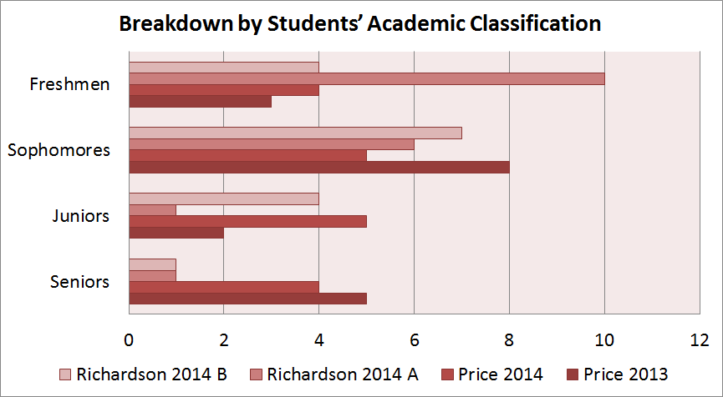

Slide 7
Academic disciplines
Students
Majors

Slide 8
Prior experience
Jefferson Community and Technical College in Louisville, Ky.
130 GEN: Introduction to Information Resources
3 credits
An exploration of the developing information society, different types of libraries, and electronic resources, such as the Internet, online databases, and information management software. Focuses on the nature of information, computer technology, and ethical computing issues.
Notes:
Similar course at previous institution

Slide 9
Source: IMDB.com

Slide 10
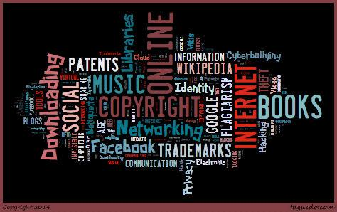
Why wasn’t it successful?
Notes:
Teaching the information lit topics
-Copyright
-Music Downloading
-Social Networking online (Facebook, etc.)
-Patents and Trademarks
-History of Libraries
-History of Books
-History of the Internet
-History of Google
-Wikipedia as a Research Tool
-Plagiarism
-Identity Theft
-Privacy in the Information Age
-Hacking
-Cyberbullying
-Netiquette
-New Communication Tools: Blogs, Wikis, etc.
-Internet addiction
-Video-sharing online
-Cloud computing
-Electronic books
-The invisible web
-Second Life and virtual worlds
-RFID tagging

Slide 11
Notes:
The true low point - pirates.

Slide 12
"In his old approach, [the student] used his standard topic for any research assignment: 'I think that’s why we always have the topic that we always keep in reserve. Like mine used to be tigers in high school. I probably did eight research papers on tigers in middle and high school.' "
(Holliday & Rogers, 2013, p. 266)

Slide 13
Why wasn’t it successful?
“Where did curry originate and how has it influenced other cultures?”
“Have more Americans over the past ten years started excepting [sic] soccer?”
“Should cheerleading be considered a sport?”
“What inspired John Wayne to enter acting and how, in turn, did he inspire future generations?”

Slide 14
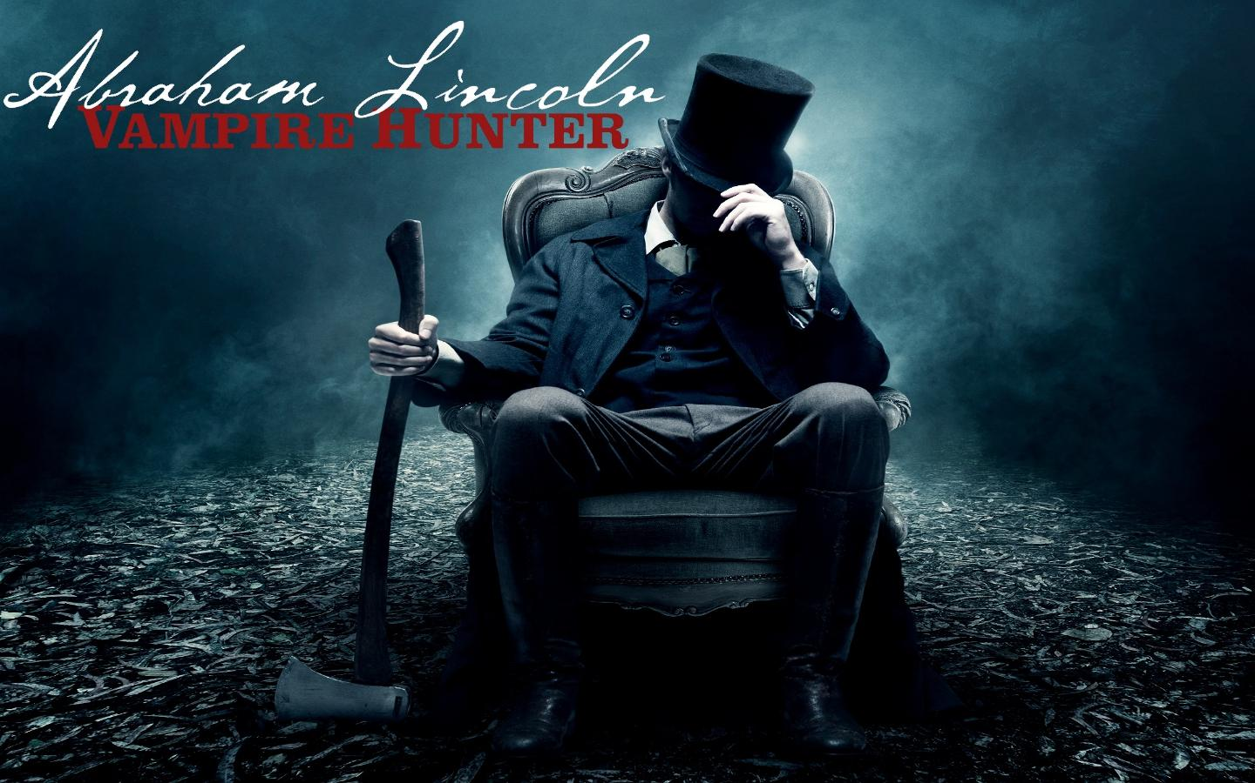
Source: Deviant Art

Slide 15
“Youngsters base any research solely on speed and ease of use.”
(Flaspohler, 2012, p. 16)

Slide 16
Solution?
Theme-based information literacy instruction
Natalie Tagge’s article from In the Library with the Lead Pipe (2012)
From the frying pan into the fire (and back again): Adventures in subject-based, credit instruction
Notes:
Comparative Societies courses aim to help “students begin to master tools and methods for becoming global citizens.” One of the academic competencies students are expected to develop in such a course is to “demonstrate basic informational literacy.” That being the case, pairing it with research skill development seemed like a natural fit: meaningful comparison necessitates skillful information discovery, assessment, and evaluation.
Broad theme South Africa: Apartheid’s Legacy
We started with reference works (Wikipedia, Britannica, atlases, etc.) and proceeded to reading books, magazine articles, government documents, and finally, scholarly articles. I introduced websites by content rather than form. For example, I presented the South African constitution as a government document that just happened to be available on a website. Allowed her to build up to reading scholarly journals.

Slide 17
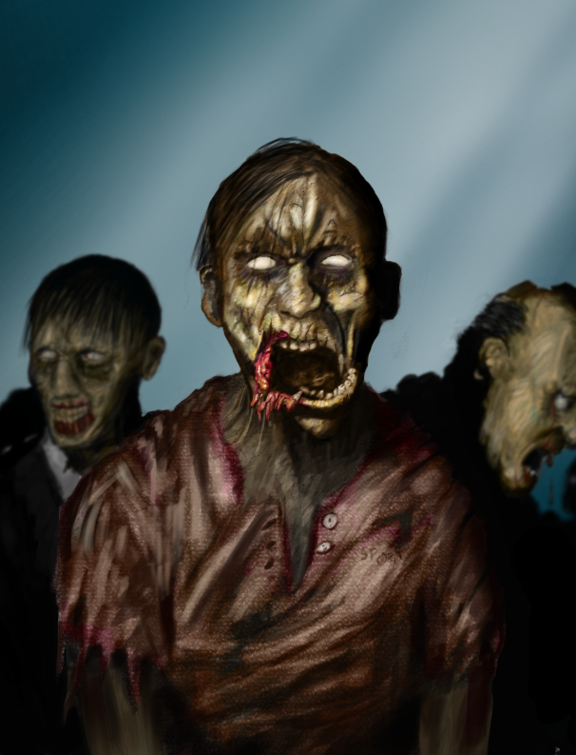
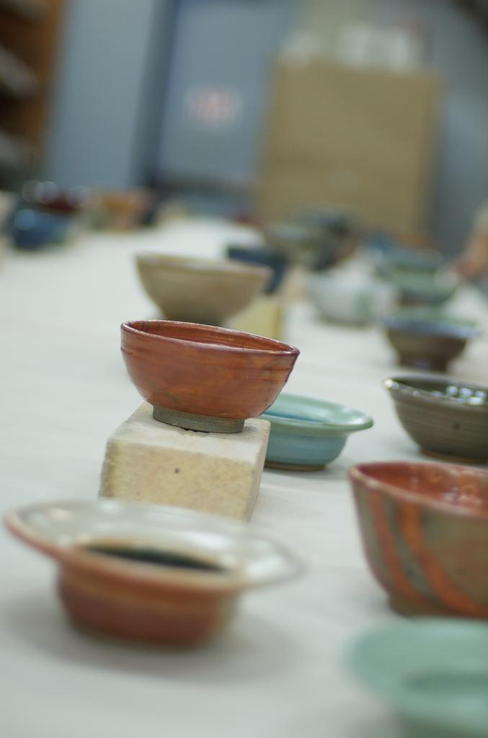
Applied themes
Zombies
(Stahura & Milanese, 2013)
Hunger
(Barry, 2011)
Music
(Kitts, 2012)
Personal finance
(Bergstrom & Price, 2013)
Notes:
Stahura & Milanese - Harrison College in Indiana (Z-Day after zombie apocalypse - your bibliographies will help the U.S. government deal with the fallout and regroup)
Maureen Barry - Wright State U., service learning course where students were creating research bibliographies for Children’s Hunger Alliance, an area agency working to end hunger.
Royce Kitts teaches at Washburn University in Kansas. Saw him present at ACRL in 2012. It teaches more basic literacy, structured around his theme of “You’re in a band.” Other assignments: band goes on tour, band member has a medical condition.
Personal finance - I left JCTC with a course mapped out that I didn’t get to teach. My theme was money, which George, a former business librarian, spun into personal finance to resonate with our students.

Slide 18
Barbara Fister, citing research by Holliday and Rogers (2013), described the problem thus: “Stop talking about ‘finding sources’ [and] frame the work as learning about something.”
(Fister, 2013)

Slide 19
Using the theme
No set way to do this
We took completely different approaches

Slide 20
Becky’s theme
Notes:
Describe theme and its evolution.

Slide 21
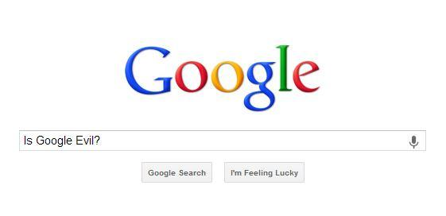
Elizabeth’s theme
Notes:
Mention IDC 199 course.
Was planning to teach my LOR course about online identities (digital footprints).
Google class was so much fun that I adapted it into my LOR class.
Students in groups developed theses that would help us answer the question - Is Google Evil?
Several groups concerned with privacy, another group looked at corporate culture and how it influences success, another looked at how YouTube is enforcing copyright. The best project though came from a pair of teachers who looked at using Google Drive in the classroom. It’s why I would probably put students together by majors next time I teach the course.
The difference between our approaches is that I taught a course about Google, and worked information literacy concepts into it. Becky taught an information literacy course that focused its research on different aspects of digital footprints/privacy. We both found success in teaching this way, but we’re both perfectionists (so neither of us is completely perfect with it).

Slide 22
“[The theme] improved student research tremendously. Now, projects demonstrated a thorough understanding of topic, and annotations showed us students were actually reading and comprehending the materials discovered.”
(Stahura & Milanese, 2013)

Slide 23
Student Benefits
Improved theses
Ability to analyze sources for usefulness rather than summarize abstract or basic information
Peer teaching opportunities
Enough sources to write 5-10 page paper

Slide 24
Improved theses
2013 Theses based on interests
What were the living conditions for the typical French buccaneer during the buccaneering period?
How do illegal performance enhancers affect the personal lives of professional athletes?
What effect does it have on a person / group when their music is bettered [sic] remembered than the individual?
2014 Theses based on theme
Are computer advertisements that have been selected based on your computer browsing history an invasion of privacy?
In what way does privacy affect the psychological development of children?
Should privately owned collections of cultural property be disclosed and surrendered to the state under Archaeological Conservancy preservation regulations?

Slide 25
Improved theses
2013 Theses based on interests
What are the different types of marketing campaigns made by major shoe companies?
What are the benefits of legal performance enhancing substances?
Who are the employees working in sweatshops, what are their conditions, which U.S. companies have been discovered employing sweatshop workers, and what is the government doing about them?
2014 Theses based on theme
How are K-12 teachers in the United States transitioning to Google Drive-based instruction?
How is Google search biased, and what are the consequences for users?
How does Google use your personal information as it expands beyond search?

Slide 26
“They struggled with evaluating, selecting, and putting trusted information to good use once they found it—the core set of information competencies that are critically important to the college-level research process.”
(Head, 2013, p. 30)
Notes:
This is why I felt like such a failure. They had found what I had asked, but the evaluating, selecting and using were a failure. Once I taught with the them - though

Slide 27
Instructor benefits
Built knowledge by starting with background info
Less “worksheet” answering
More critical thinking about sources
Better class discussions
Easier for instructor to grade a single topic
And you feel less hopeless as an instructor
Re-energized passion for teaching
Opportunities in marketing course to students

Slide 28
“One of the first challenges in developing a course that was topical rather than library-focused was deciding on a content focus.”
(Tagge, 2012)

Slide 29
Choosing a theme
Activity:
Side 1 of worksheet
List 3 topics/themes of interest to you (2 minutes)
Finished? Trade sheets with shoulder partner
Side 2 of worksheet
Pick one topic from front of sheet
Write down three research questions related to majors at your college/university (5 minutes)
Finished? Discuss in pairs...

Slide 30
“Framing information literacy as ‘learning about’ means not only changing the words we use; it also re-directs our own practice as teachers, especially in where we focus our instructional attention.”
(Holliday & Rogers, 2013, p. 268)

Slide 31
Acknowledgements
Special thanks to George Bergstrom at Sullivan University for his research help and contributions in developing this topic for presentation.
gbergstrom@sullivan.edu

Slide 32
Contact information
Becky Richardson
rrichardson5@murraystate.edu
Elizabeth Price
eprice4@murraystate.edu
Email addresses and short URL for slides available on handout.

Slide 33
References
Badke, W. (2008). Ten reasons to teach information literacy for credit. Online, 32(6), 47-49.
Barry, M. (2011). Research for the greater good: Incorporating service learning into an information literacy course at Wright State University. College & Research Libraries News, 72(6), 345-348.
Beilin, I., & Leonard, A. E. (2013). Teaching the skills to question: A credit-course approach to critical information literacy. Urban Library Journal, 19(1), 1-10.
Burkhardt, J.M., MacDonald, M.C., & Rathemacher, A.J. (2010). The paper trail project. Teaching Information Literacy: 50 Standards-Based Exercises for College Students. Chicago: American Library Association, 101-121.
Flaspohler, M.R. (2012). The Millennials go to the library: Or do they? In Engaging first-year students in meaningful library research: A practical guide for teaching faculty. Oxford: Chandos, 13-42.

Slide 34
References
Fister, B. (2013, January 18). Welcome to the Palace of Ambiguity. Library Babel Fish. Retrieved from http://www.insidehighered.com/
Head, A.J. (2013). Learning the ropes: How freshmen conduct course research once they enter college. Project Information Literacy. Retrieved from http://projectinfolit.org/images/pdfs/pil_2013_freshmenstudy_fullreport.pdf
Holliday, W. & Rogers, J. (2013). Talking about information literacy: The mediating role of discourse in a college writing classroom. Portal: Libraries and the Academy 13(3), 257-271.
Kitts, R. (2013, April 11). Get moving with library instruction. Lecture presented at Association of College and Research Libraries, Indianapolis.

Slide 35
References
Kuh, G. D. (2007, June 15). How to help students achieve. Chronicle of Higher Education, 53(41), 12-13. Retrieved from Academic Search Complete.
Price, E. and Bergstrom, G. (2013). Gilligan, Norm and a few Friends: Using a theme to make your course more meaningful. Presented at Kentucky Library Association Library Instruction Round Table Conference at Eastern Kentucky University in Richmond, Ky.
Stahura, D. and Milanese, E. (2013). Teaching with zombies: Bringing information literacy back from the dead. College & Research Libraries News 7(4), 354-356. Retrieved from http://crln.acrl.org/content/74/7/354.full
Tagge, N. (2012, March 7). From the frying pan into the fire (and back again): Adventures in subject-based, credit instruction. In the Library with the Lead Pipe. Retrieved from http://www.inthelibrarywiththeleadpipe.org

